Slide 1
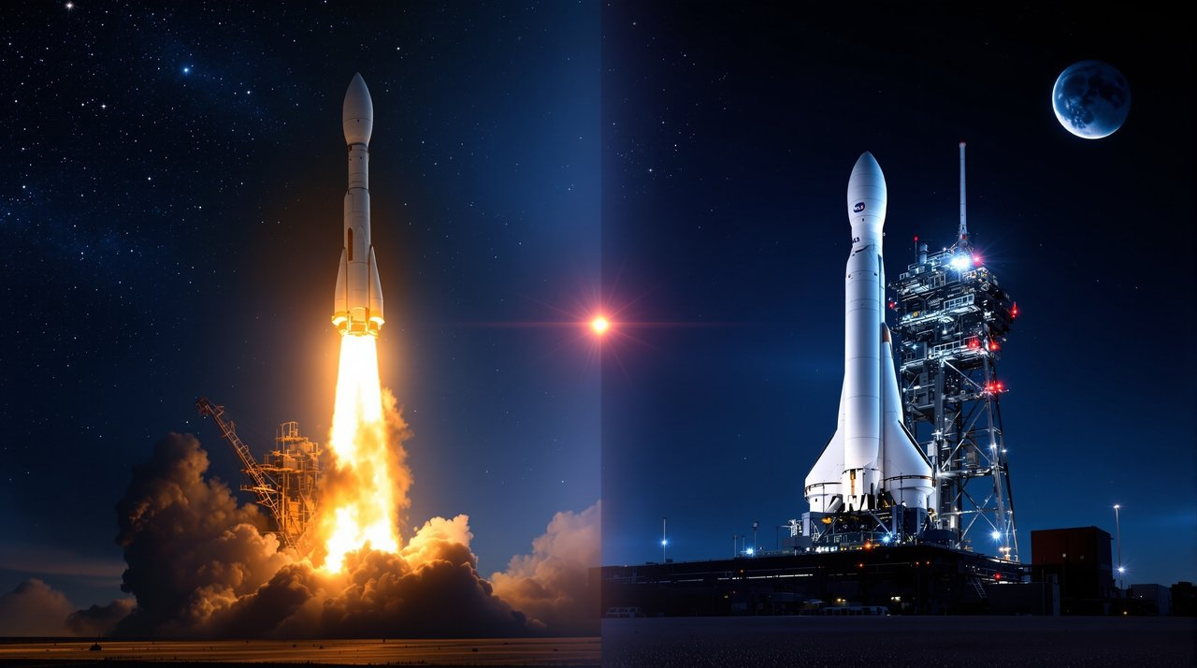
APOLLO TO ARTEMIS
THE SPACE NARRATIVE
From the first lunar footsteps to a sustainable return—how Apollo's legacy powers Artemis and the path to Mars.

Slide 2
Agenda
Key Figures & Quotes
Vehicle Evolution (Saturn V → SLS/Orion; Starship context)
Mission Timeline (Apollo to Artemis)
Budget Trends (inflation-adjusted)
Technology Advances (materials, computing, guidance)
Risks & Mitigations
International Partners
Cultural Impact
What's Next

Slide 3

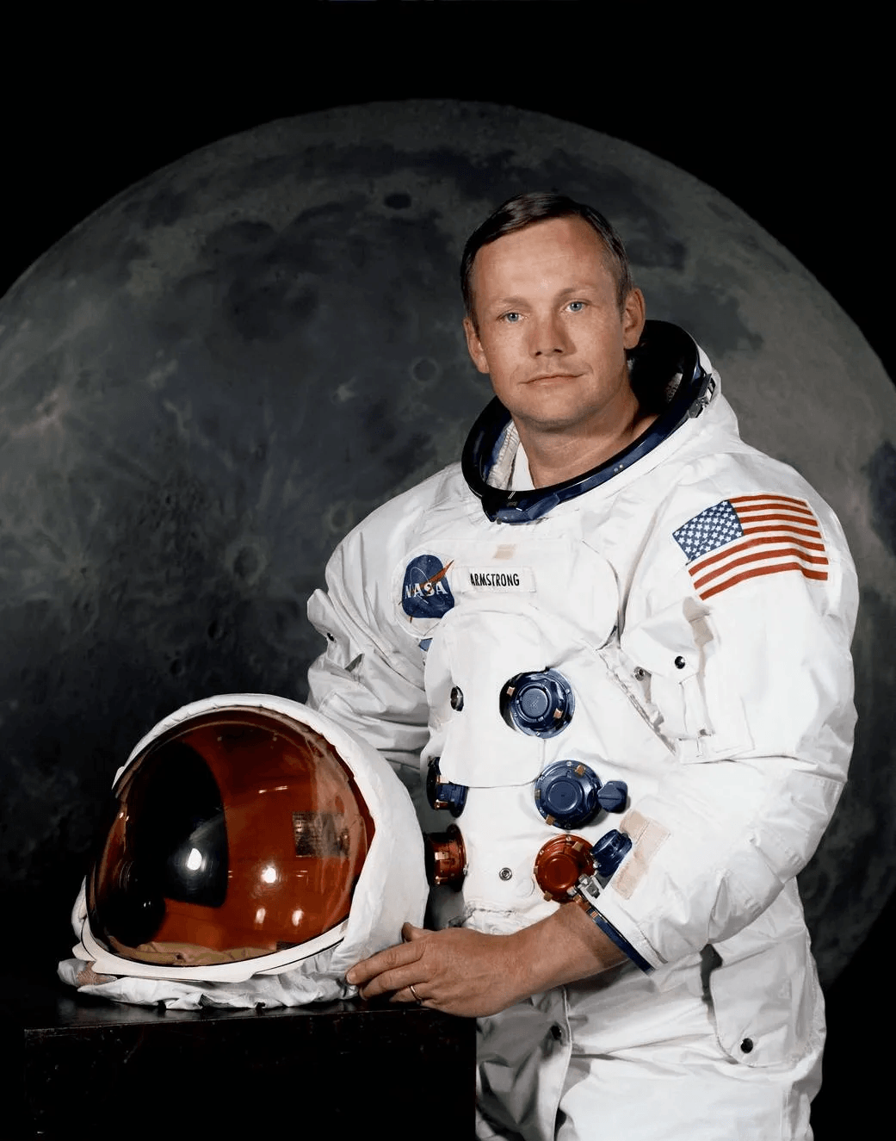
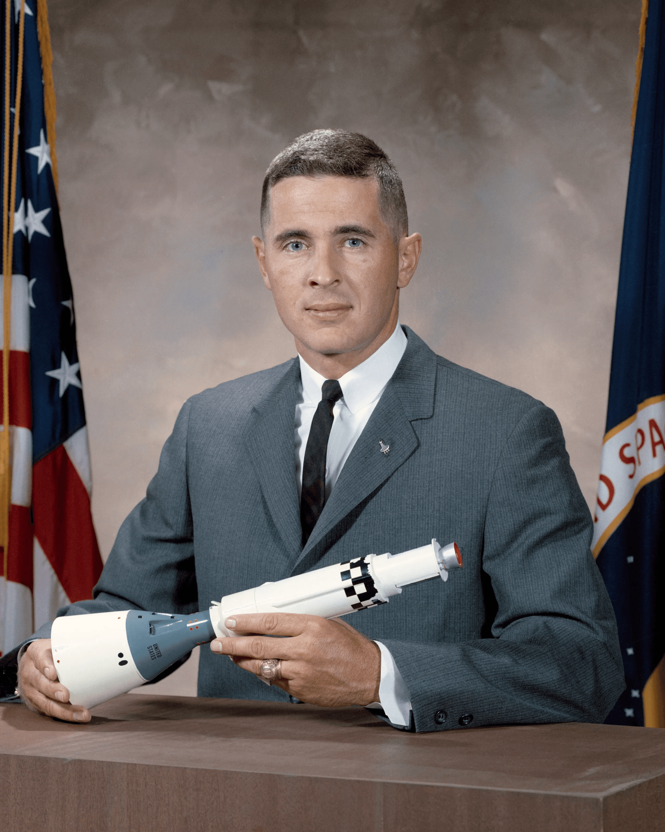
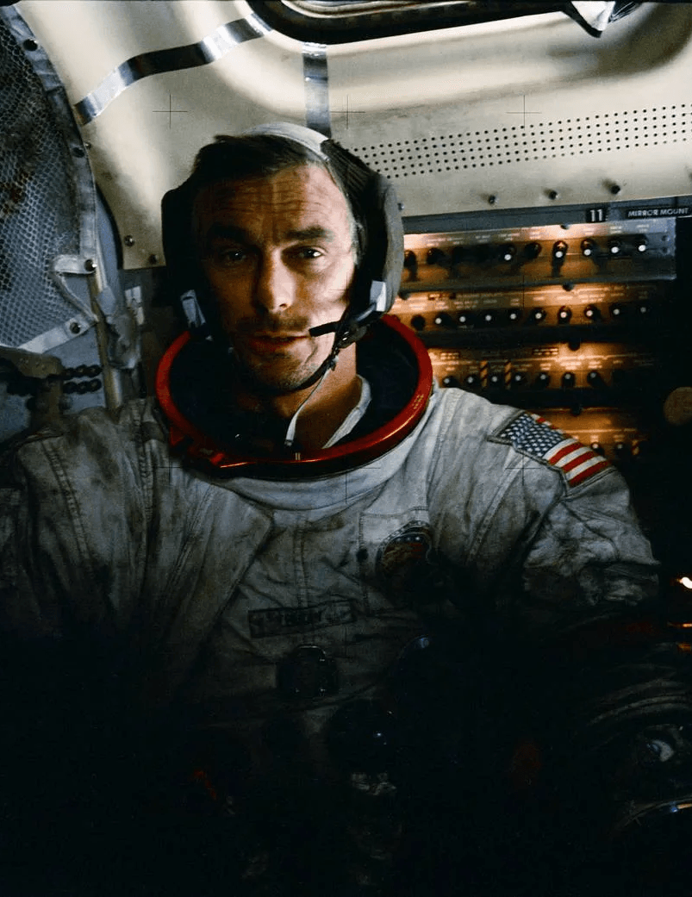
Key Figures & Quotes
John F. Kennedy
Neil Armstrong
Set the Moon landing goal (1961 Rice speech). Catalyzed Apollo funding, schedule, and national focus.
Commander, Apollo 11; first human on the Moon. Test pilot; Gemini and Apollo astronaut.
We choose to go to the Moon in this decade and do the other things, not because they are easy, but because they are hard.
That's one small step for [a] man, one giant leap for mankind.
Bill Anders
Gene Cernan
Apollo 8 astronaut; captured the iconic Earthrise photo. Helped shift public perspective to a fragile Earth.
Apollo 17 commander; last human to walk on the Moon (1972). Geology-focused exploration with Harrison Schmitt.
We came all this way to explore the Moon, and the most important thing is that we discovered the Earth.
We leave as we came, and, God willing, as we shall return, with peace and hope for all mankind.

Slide 4
Vehicle Evolution: Saturn V → SLS/Orion (with Starship Context)
Apollo Era (Expendable)
Artemis Era (Expendable)
Commercial (Reusable)
Payload to Low Earth Orbit (tons)
Saturn V
~140 tons
SLS Block 1
~95 tons
SLS Block 1B
~105 tons
Starship
100-150 tons
Payload to Trans-Lunar Injection (tons)
Saturn V
~48 tons
SLS Block 1
~27 tons
SLS Block 1B
~38-42 tons
Starship
≥100 tons*
SLS Block 1
SLS Block 1B
* With on-orbit refueling. TLI lift varies by trajectory and margins; values are approximate.
Saturn V
System
Starship
Era
Notes
Saturn V + Apollo CSM/LM
1967–1973
Expendable; three-stage kerolox/hypergolic; Moon landings via LM.
SLS Block 1 + Orion
Artemis I–III
Expendable; RS‑25 + 5‑segment SRBs; Orion for deep-space crew.
SLS Block 1B + Orion
Artemis IV+
EUS upper stage; Gateway and larger payloads.
Starship (HLS variant)
Artemis III+ (provider)
Fully reusable; lunar lander under NASA contract.

Slide 5

Mission Timeline: Apollo to Artemis
APOLLO ERA
ARTEMIS ERA
1961
1969
1972
2014
2022
2026
JFK sets Moon goal
Apollo 11: first lunar landing
Apollo 17: last Moon landing of Apollo era
Orion EFT-1 uncrewed test (Earth orbit)
Artemis I: uncrewed SLS/Orion lunar mission
Artemis III: crewed lunar landing (NET)
1968
1970
2011
2020
2025
2028
Apollo 8: first lunar orbit; Earthrise
Apollo 13: safe return after anomaly
SLS authorized; Orion capsule baseline
Artemis Accords framework announced
Artemis II: crewed lunar flyby (NET)
Artemis IV: Gateway assembly; SLS Block 1B (NET)
NET = No Earlier Than; schedules subject to change.

Slide 6
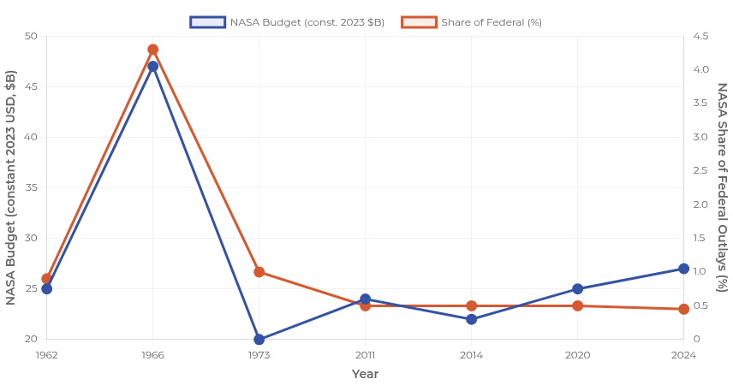
Budget Trends (Inflation-Adjusted)
Insights
Apollo peak: NASA ≈4.3% of U.S. federal outlays (1966); constant-$ peak far above current levels.
Artemis era: NASA ≈0.4–0.5% of federal outlays; Exploration accounts rising but below Apollo scale.
Modern costs reflect safety, sustainability, and broader science/LEO programs.
Values are indicative and rounded; constant-dollar conversions depend on index choice.

Slide 7
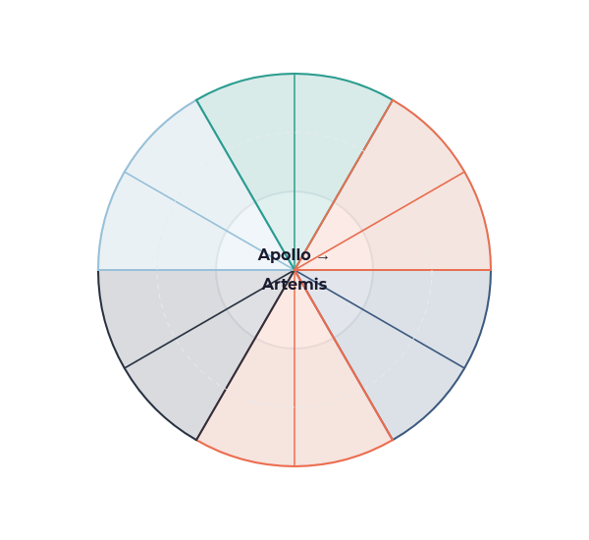






Technology Advances: Materials, Computing, Guidance
From aluminum alloys to Al-Li, composites, and additive-manufactured engine parts
Ablative heat shields → refined TPS materials and arc-jet validated repairs
Apollo Guidance Computer → modern rad-hard processors with fault tolerance
Inertial platforms → strapdown IMUs + star trackers + GNSS assist
Deep-space communications including optical/laser links for higher bandwidth
Closed-loop ECLSS improvements for deep-space long-duration missions
Materials
TPS
Computing
GNC
ECLSS
Comms

Slide 8

Risks and Mitigations
Heat shield/charring behavior
Design refinements; arc‑jet/flight‑like test coupons; instrumented reentry data closeout before crewed flight
High‑energy reentry performance uncertainties
Likelihood × Impact Matrix
Deep‑space radiation exposure
Storm shelters; passive materials; mission timing; dosimetry and operational constraints
1
4
6
2
Solar Particle Events (SPEs), Galactic Cosmic Rays (GCRs)
3
5
Lunar landing precision
Terrain Relative Navigation (TRN), autonomous hazard detection, rehearsals with uncrewed demos and simulations
Hazard avoidance in challenging terrain
High
On‑orbit propellant transfer
Incremental demos; boil‑off control; multi‑tanker architecture with ground test correlation
Cryogenic handling for HLS refueling
Impact
Integration complexity
Interface control, phased verification, margin reserves, independent readiness reviews
Schedule challenges across multiple providers
Budget volatility
Modular milestones, international cost‑sharing, multi‑year procurement strategies
Low
Policy shifts affecting program continuity
Low
Likelihood
High

Slide 9


International Partners
ESA (Europe)
JAXA (Japan)
ESA
Orion European Service Module
JAXA
Gateway life support/logistics (HTV‑X derivatives)
Gateway modules (I‑HAB, ESPRIT)
Lunar surface systems studies
Science payloads
CSA (Canada)
Commercial (U.S.)
CSA
Canadarm3 for Gateway robotics
HLS providers (e.g., Starship, Blue Moon)
AI‑enabled autonomous operations
CLPS lunar deliveries
Comms, nav, habitats
Artemis Accords
World map with partner distribution: North America, Europe, Asia regions highlighted as major contributors
30+ signatories aligning on interoperability, transparency, safe operations
International framework for peaceful space exploration

Slide 10
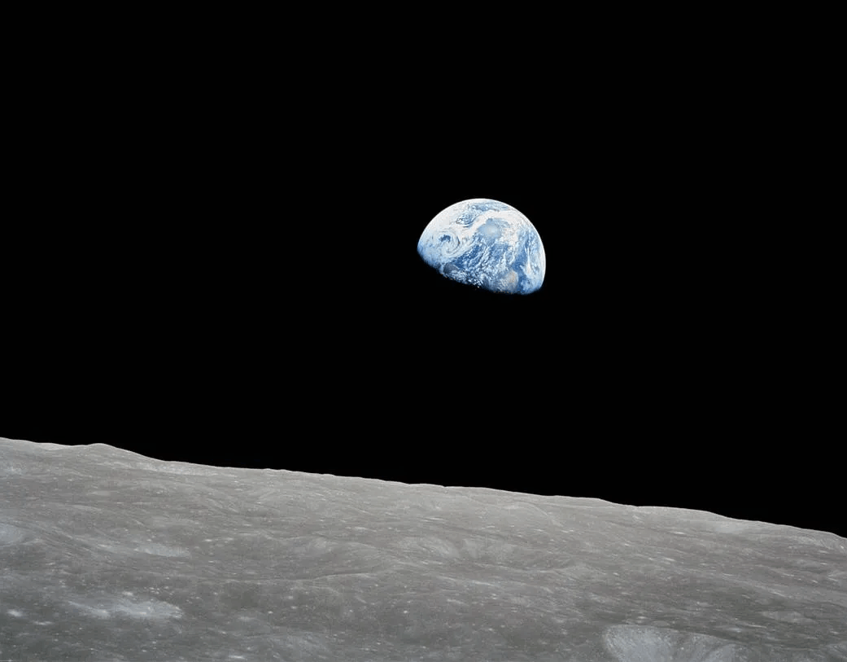
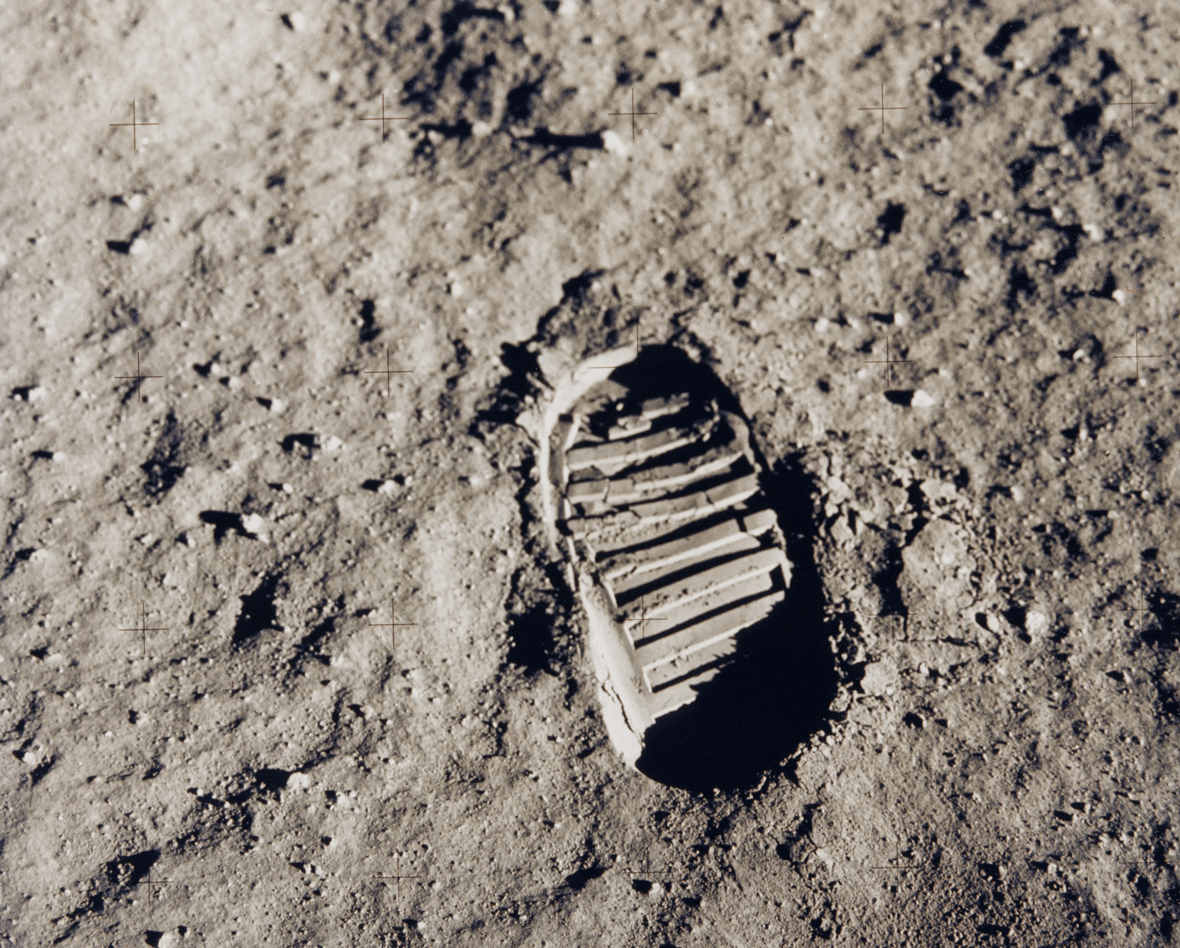
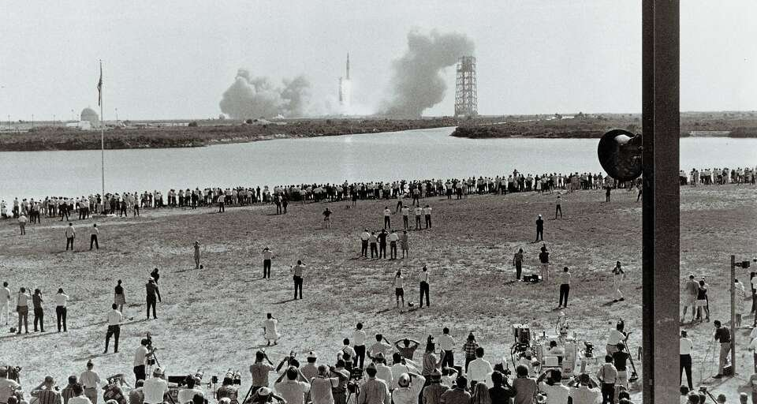
Cultural Impact
Earthrise (Apollo 8) reshaped global environmental awareness
Apollo achievements
Sustainable exploration via Artemis
Education & workforce
Policy & cooperation
Imagery & media
Iconic symbol of human exploration
STEM inspiration: generations of scientists, engineers, and explorers
Shared global moments: live broadcasts, classroom lessons, public art and film
Artemis expands representation: commitment to land the first woman and first person of color on the Moon
Commercial era storytelling: new icons, new access, broader participation

Slide 11
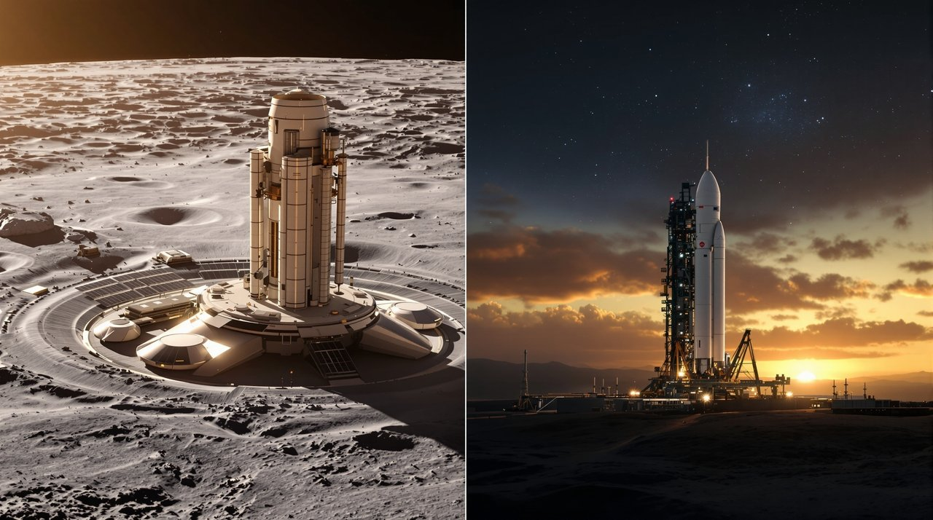
What's Next
Near Term (0–3y)
Mid Term (3–7y)
Long Term (7y+)
Missions
Missions
Missions
Artemis II crewed lunar flyby (NET 2025).
SLS Block 1B and Orion upgrades for increased cargo capacity.
Sustained lunar presence with repeat landings.
Artemis III lunar landing (NET 2026) using HLS.
Mars pathfinding missions.
CLPS missions delivering instruments.
Artemis IV (2028)
Sustained Surface Ops (2030)
Artemis II (2025)
Gateway
Gateway
Artemis III (2026)
Assembly of power/propulsion, habitation, and logistics modules.
Enhanced logistics, extended habitation capabilities, and international expansion.
Gateway
Enabling longer lunar stays.
Initial module development and assembly preparations.
Gateway Ops (2028)
Surface Systems
Expanded lunar base capabilities, long-duration habitation.
Surface Systems
Surface Systems
Mobility platforms, power systems, and initial habitats.
Technology demonstrations at south polar region.
Science & ISRU
Science & ISRU
ECLSS closure experiments, radiation countermeasures, propellant production.
Science & ISRU
Initial ISRU experiments; resource mapping and utilization tests.
Polar volatiles characterization; initial experiments.
Commercial cislunar economy growth.
Schedules subject to change with testing outcomes, policy, and partner readiness.

